Slide 1
Lesson plan 5: Security & ethics and Application writing

Slide 2
Recap: What are some of the key stages in the journey of taking an idea and making it into a solution?

Slide 3
Activity: Exploring ethics and technology
What do you think of when you hear the word “ethics”?
What do you think some of the ethical issues might be when using technology?
Why do you think ethics is linked to security?

Slide 4
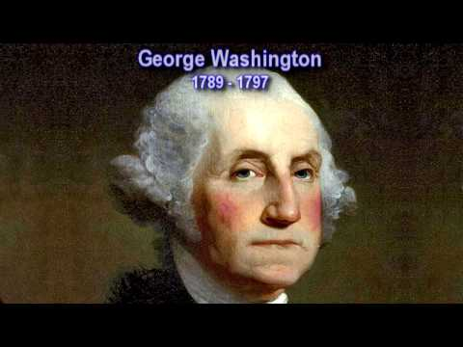
Activity: Example of Bias

Slide 5
Activity: Example of transparency and privacy

Slide 6
Activity: Example of cybersecurity

Slide 7
Task: Time for completing your application form
Download the application form word document here: https://longitudeexplorer.challenges.org/
Tip: all the work they have done so far will help you to write you answers to the form and you only need complete section 2 - Your Idea!

