Slide 2
What would you like to change about the world?
Take a minute to think about something you’d like to change in your community - or in even in the world!
Ask yourself, are there any problems or issues you feel strongly about?

Slide 3
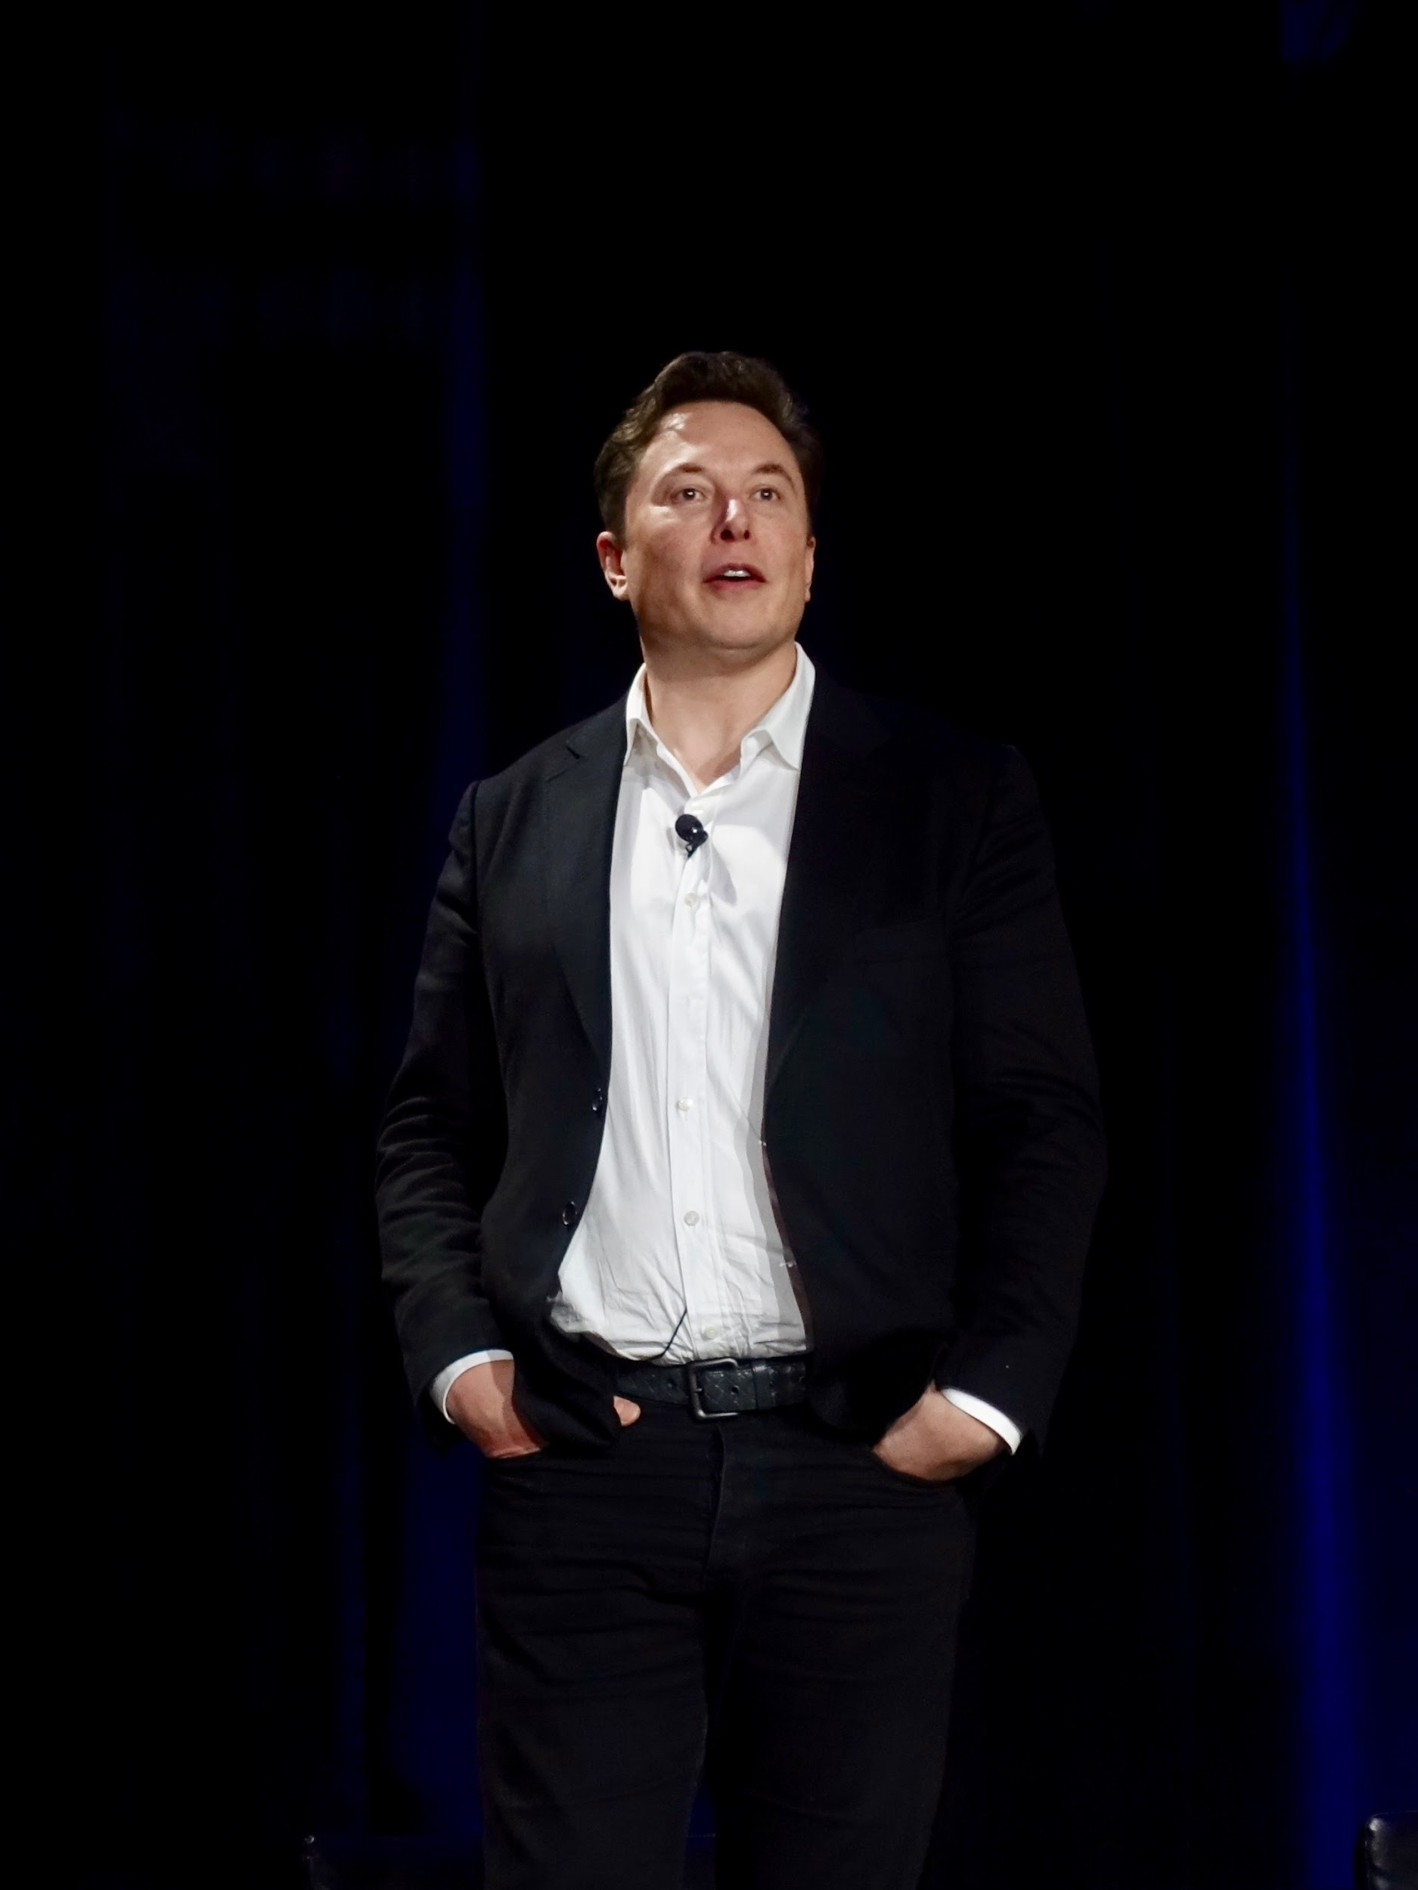
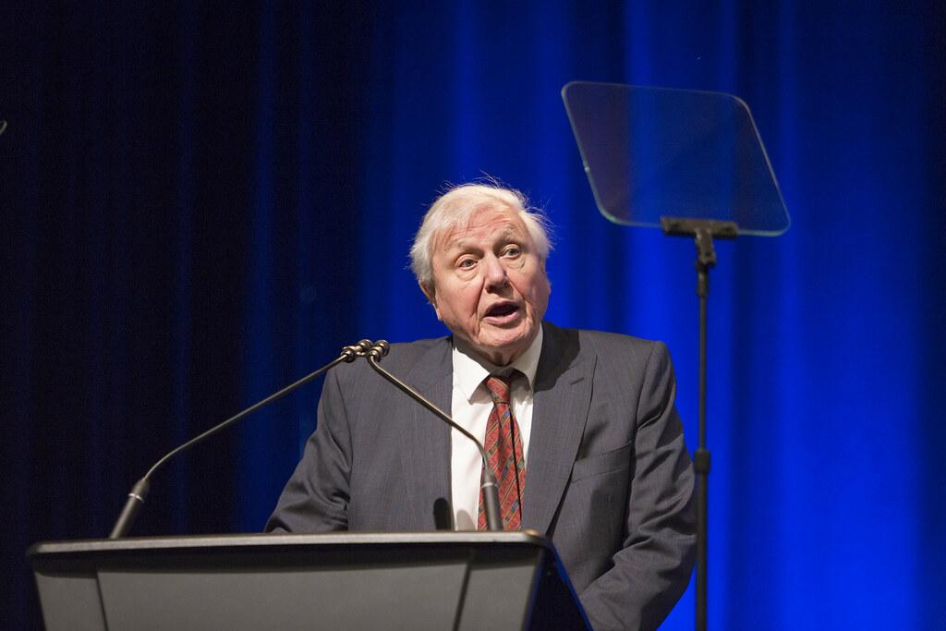
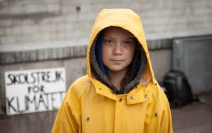
Who are you inspired by?

Slide 4
You’re ready to take on a new challenge!
If you’ve thought of something then you’re already ready to take on this new challenge...

Slide 5
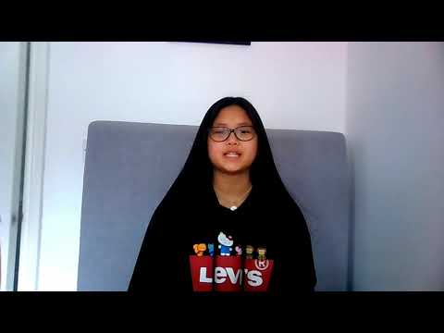
Introducing the Amazon Longitude Explorer Prize
A prize dedicated to supporting you to solve issues you care about - by making your ideas become a reality!
Check out last year’s winners...

Slide 6
This year’s challenge
How can you use technology to create an app, product or service that will make the world a better place, enabling people to Live Better, Live Longer, Live Greener and Live Together?

Slide 7
The themes
Living Better
How can we use technology to help us catch illnesses earlier and recover more quickly, help us stay happy and healthy in our day to day lives, and improve the lives of others?
Live Greener
How can we use technology to help protect our planet?
Living Together
How can we use technology to help us live together and stay connected in a way that is easy, safe and environmentally friendly?
Living Longer
What can technology do to meet the needs of an ageing society?

Slide 8
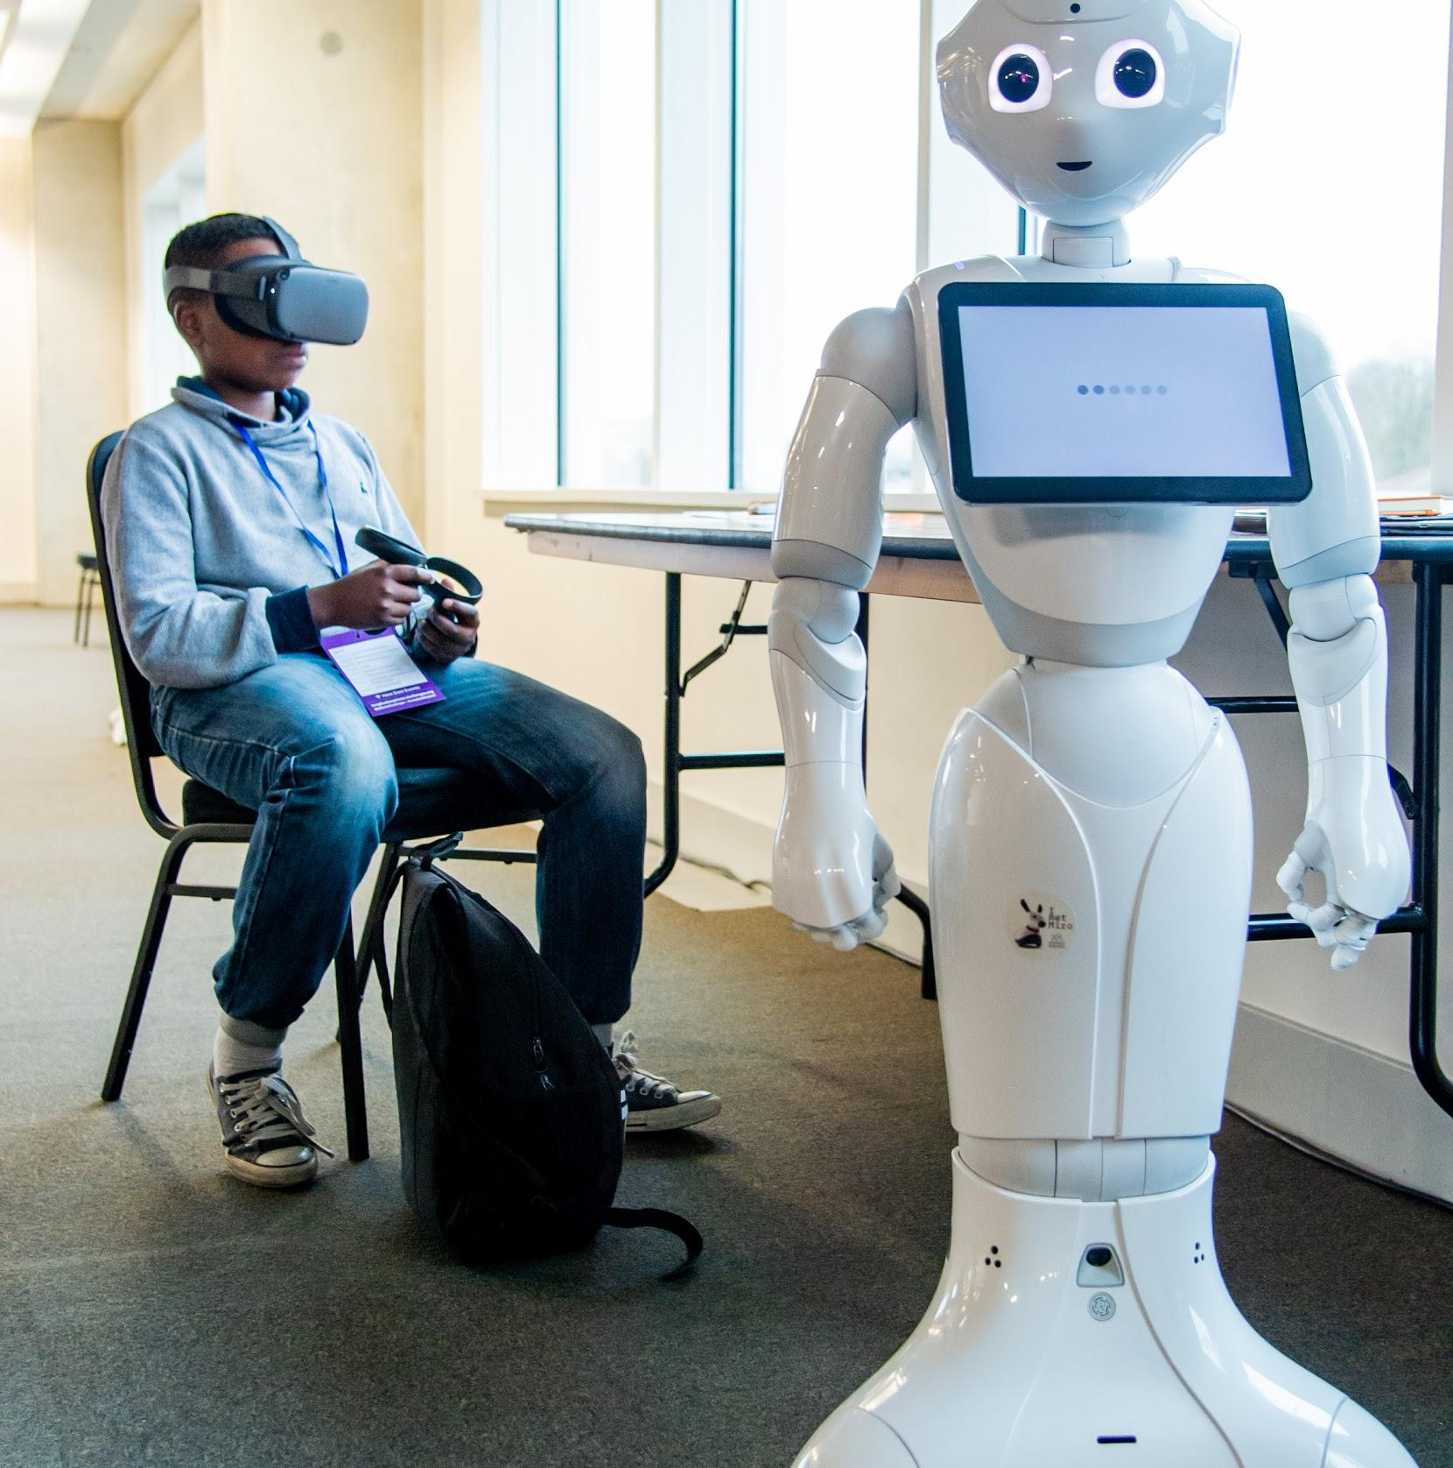
Why should we take part?
You’ll have fun! You apply as a team so you will get to work with friends/classmates to come up with new ideas.
You can make a real difference! Apply what you’ve been learning at school to real life problems and issue that you care about.
An exclusive experience! An opportunity to take part in an exclusive business school experience and learn from experts in both business & STEM.
Work with a whole generation of young people! Meet other young people across the UK who are interested in similar things to you.
Prizes! An opportunity to win individual prizes & money for your school/group!

Slide 9
What have previous winners built?
2016/2017: Artificial Intelligence
TOMODACHI: A smartwatch app operating as a personal assistant to support us as we grow older.
2016/2017: Internet of things
OctopixA: A prototype that helps people with Autistic Spectrum Disorder to communicate through a wearable badge which uses a number of sensors that measure stress, heart rate,and speech and tone emotion.
2015/2016: Satellite technology
Displaced: A mobile app designed to help charities to coordinate the logistics of supporting vulnerable people around the world.

Slide 10
Stages of the competition
Entry stage: Submit your idea (2 November 2020) – 12 February 2021) | Finalist stage: Making your idea a reality (April - June) | Awards and Prizes (July)
Work together to fill out the online application and remember to submit before the deadline: 12th of February 2021! | 40 teams will be selected by an expert panel of judges. 40 teams selected by expert judges will be invited to participate in an exclusive business school experience make their idea a reality. Finalists will be invited to pitch to the panel of judges! | The winners will be awarded funds (£20,000) and connections to further develop their ideas. There will be three runners up prizes of £5,000 each, plus a people’s choice award where the public will get to vote. Don’t forget about the individual prizes as well!

Slide 11
How are our ideas judged?
Innovative use of technology | Is your project an innovative idea that uses technology for good in a new way?
Impact | Have you clearly explained the problem you are trying to solve? Can you show how your idea will help to solve it?
Enterprising | Are you able to explain clearly the steps you would take to turn your idea into a reality? Do you know what you need to do to make or build your tech product of service?
Teamwork | Were you able to work together as a team? Were the contributions and strengths of all team members recognized?
Communications | Do you have a clear plan for marketing and promoting your idea to your target audience?
Ethics and Security | Have you thought through the ethical and security impacts of your idea and how you would make your idea safe?

Slide 12
Now over to you!
With lots of resources to help you enter a winning idea at: https://longitudeexplorer.challenges.org/
Start getting your teams together and get your applications in now!
All you need is an idea...

